Slide 1
Sentiment Analysis Assignment #4
A Natural Language Processing Solution Using Python, Azure Data Factory, and Tableau
Submitted by: Satish Kumar (200574904)
Date: March 24, 2025

Slide 2
Table of Contents
Introduction to Sentiment Analysis
Project Architecture
Data Collection and Preprocessing
Model Building and Evaluation
Data Ingestion with Azure Data Factory
Visualization with Tableau
Challenges Faced
Results and Insights
Conclusion and Future Work
References

Slide 3
Introduction to Sentiment Analysis
Sentiment Analysis, also known as opinion mining, uses NLP to identify and categorize text as positive, negative, or neutral.
Applications:
Social media monitoring
Customer feedback analysis
Brand reputation management
Objective: To analyze a dataset of 1.6 million tweets and classify their sentiment using a machine learning model.

Slide 4
Project Architecture
Collection: Load dataset (Sentiment140 from Kaggle) and preprocess using Python.
Processing: Build and evaluate a Logistic Regression model for sentiment classification.
Ingestion: Use Azure Data Factory to ingest processed data into Azure Blob Storage.
Visualization: Connect Azure Blob Storage to Tableau and create a dashboard.
Tools Used: Python, Azure Data Factory, Tableau

Slide 5
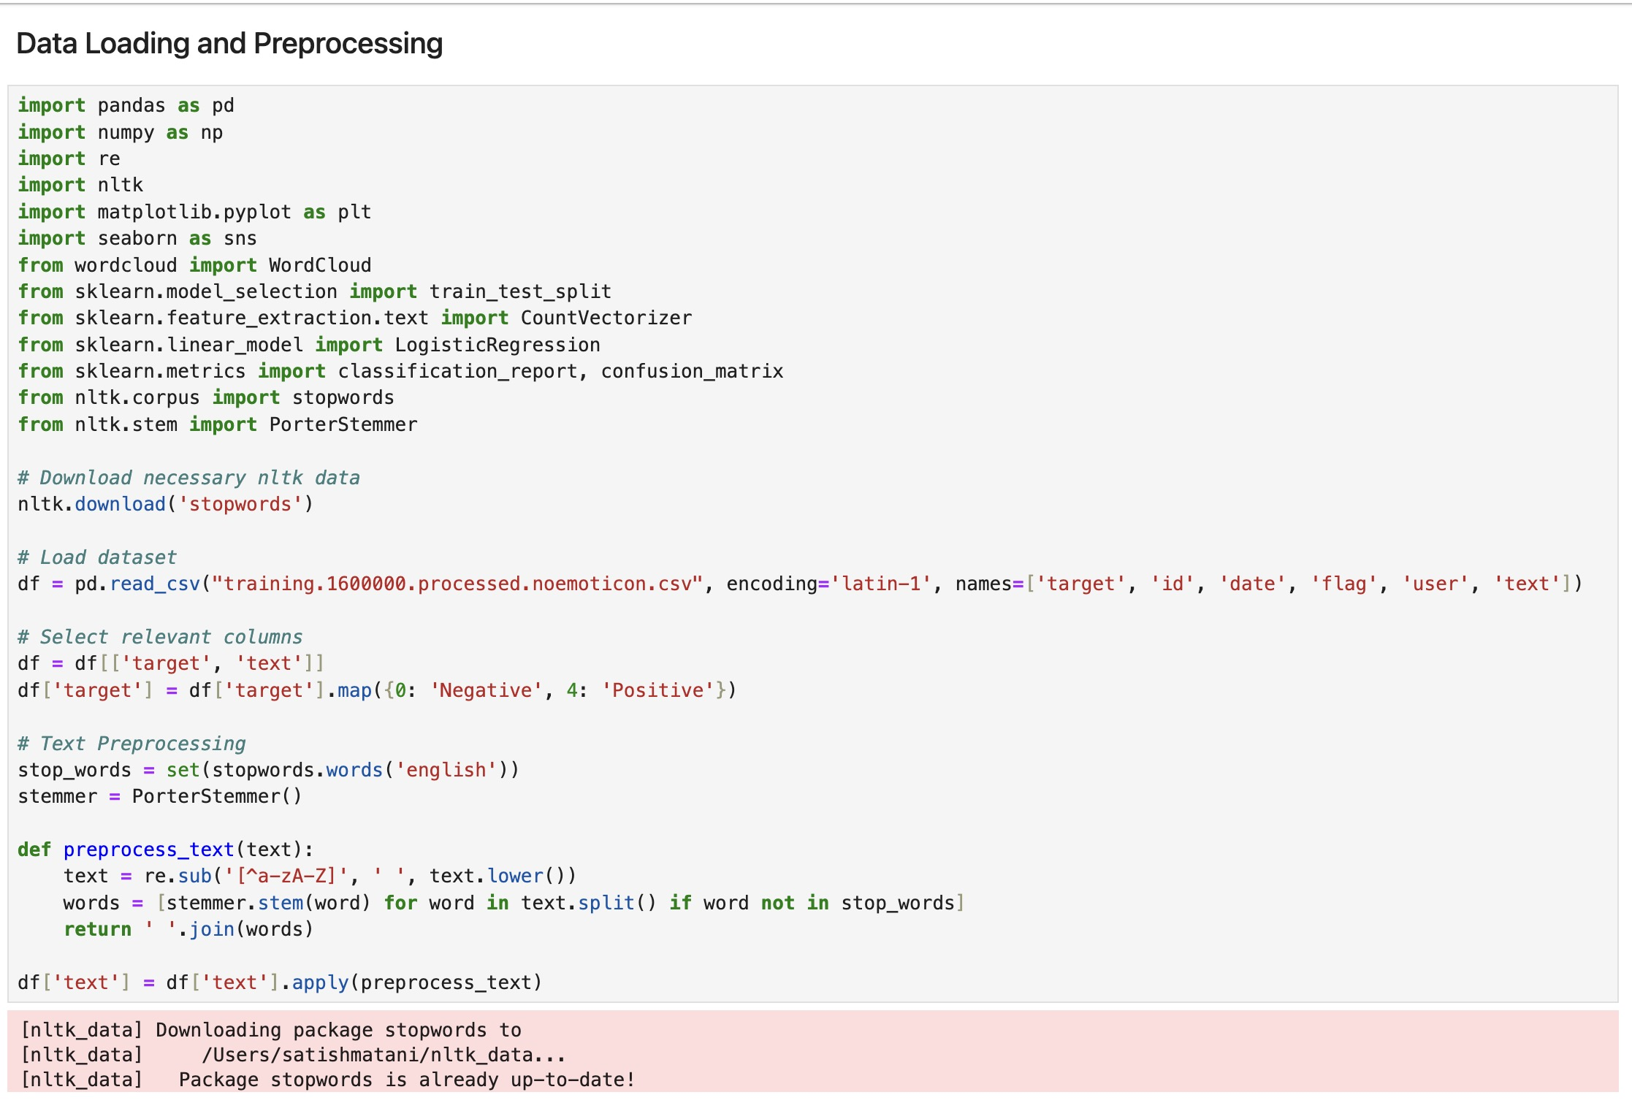
Data Collection and Preprocessing
Dataset: Sentiment140 (1.6 million tweets, Kaggle)
Preprocessing Steps:
Loaded dataset using Pandas: df = pd.read_csv("training.1600000.processed.noemoticon.csv")
Selected relevant columns: target (sentiment) and text
Mapped target values: 0 → Negative, 4 → Positive
Applied text preprocessing:
Converted text to lowercase
Removed special characters using regex
Removed stopwords using NLTK
Applied stemming using PorterStemmer

Slide 6
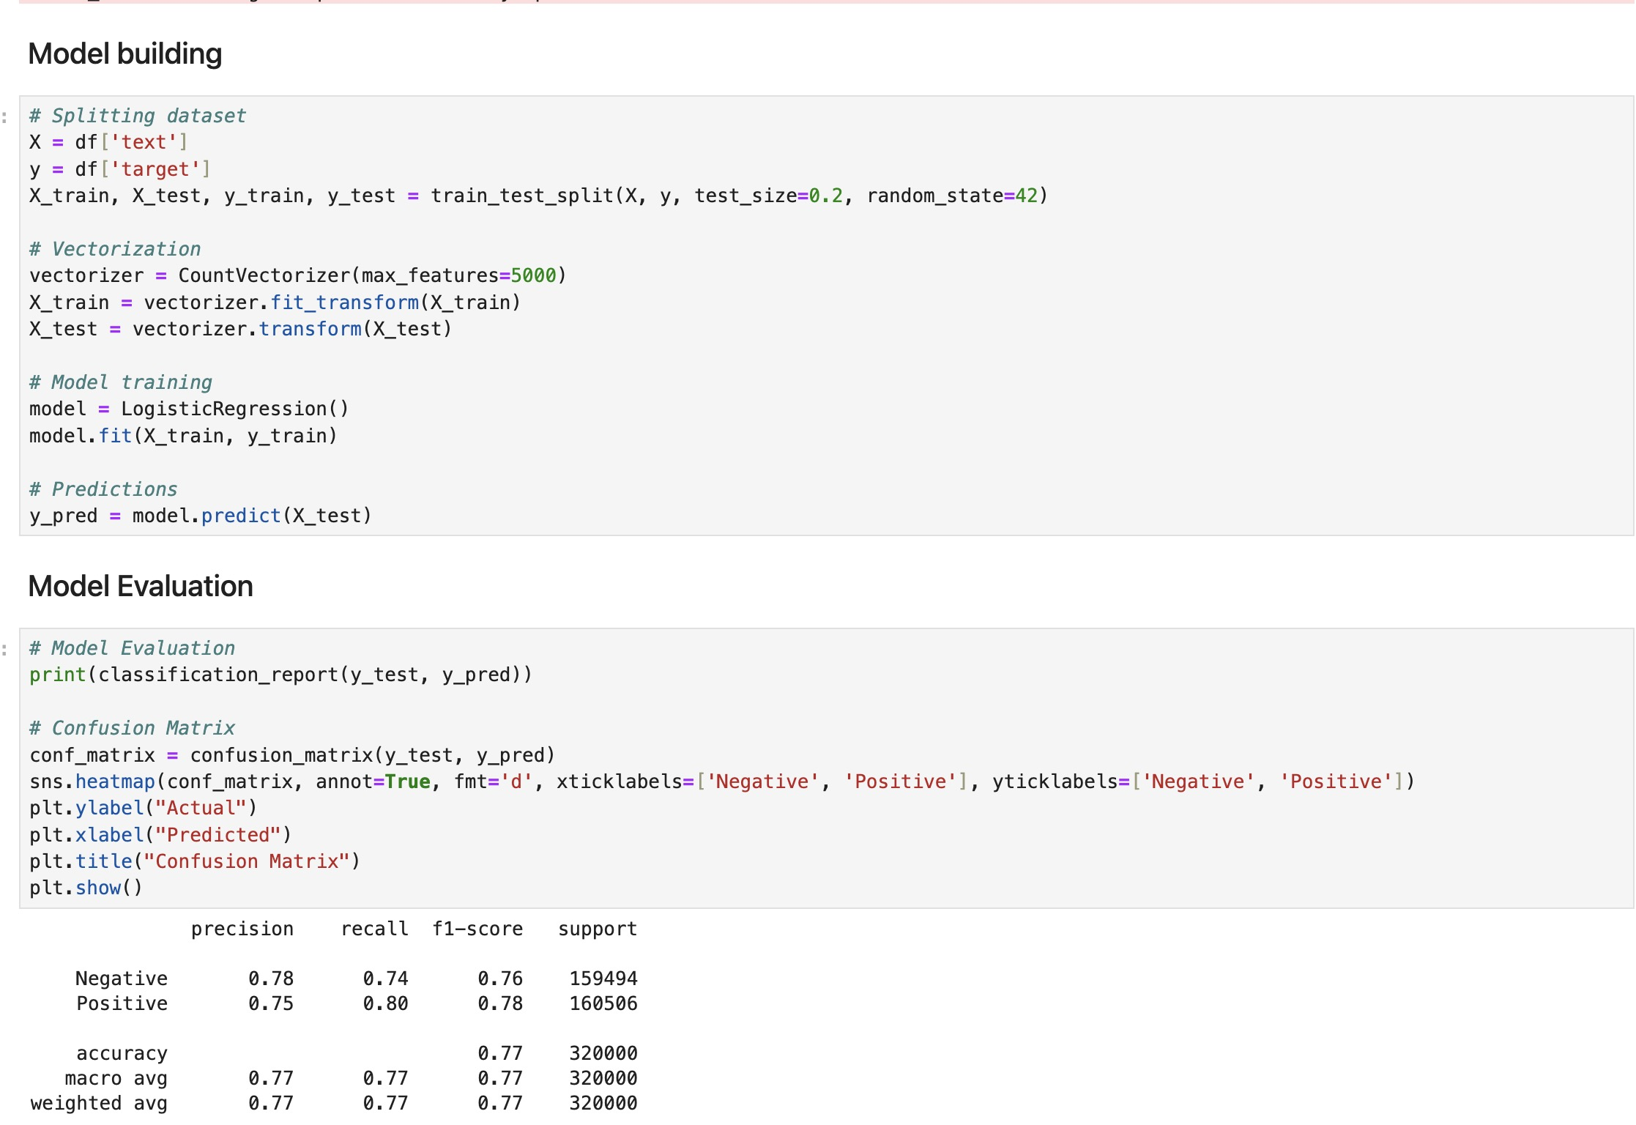
Model Building and Evaluation
Model: Logistic Regression
Steps:
Split data into training (80%) and testing (20%) sets using train_test_split
Vectorized text using CountVectorizer (max_features=5000)
Trained Logistic Regression model: model.fit(X_train, y_train)
Evaluated model using classification report and confusion matrix
Results:
Accuracy: 77%
Precision, Recall, F1-Score:
Negative: 0.78, 0.74, 0.76
Positive: 0.75, 0.80, 0.78

Slide 7
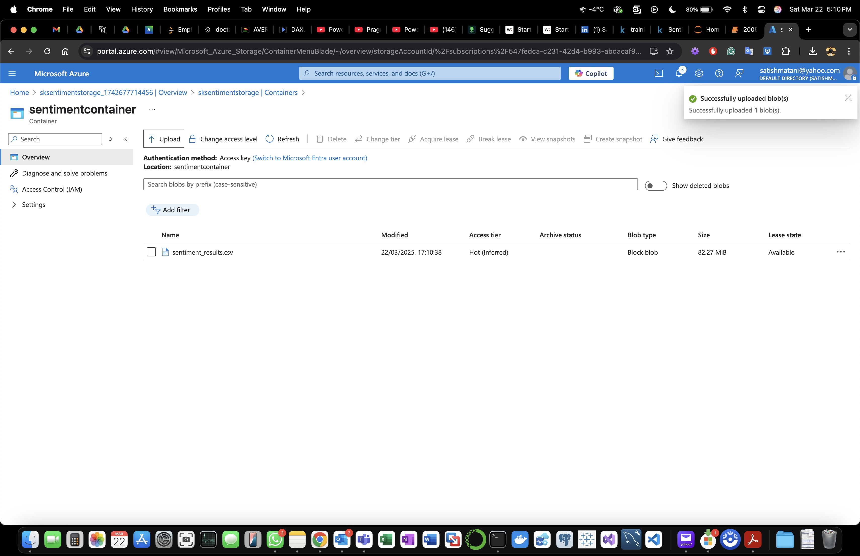
Data Ingestion with Azure Data Factory
Saved processed data as sentiment_results.csv
Uploaded to Azure Blob Storage:
Storage Account: sksentimentstorage_1742677714456
Container: sentimentcontainer
Blob: sentiment_results.csv (82.27 MiB, uploaded on 22/03/2025)
Used Azure Data Factory for ingestion:
Created a pipeline to copy data from local storage to Azure Blob Storage

Slide 8
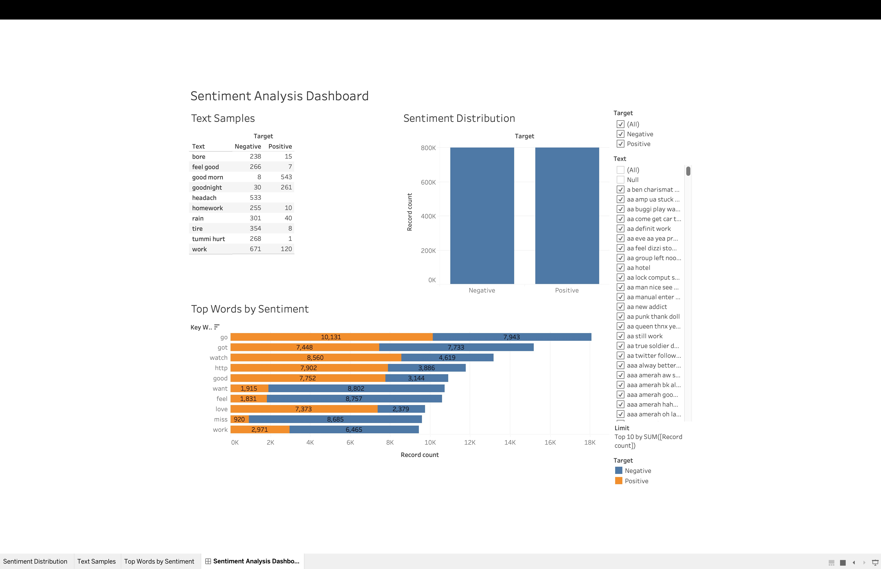
Visualization with Tableau
Connected Azure Blob Storage to Tableau
Created a Sentiment Analysis Dashboard:
Text Samples: Top 10 positive and negative words (e.g., "good" - 543 positive, "work" - 671 negative)
Sentiment Distribution: Histogram showing 800K negative and 800K positive tweets
Top Words by Sentiment: Bar chart comparing word frequencies (e.g., "go" - 10,131 positive, 7,943 negative)
Target: List of sample tweets with their sentiment

Slide 9
Challenges Faced
Data Preprocessing: Handling noisy text data (e.g., special characters, inconsistent formatting) required extensive cleaning.
Model Performance: Initial accuracy was low (~65%) due to imbalanced features; improved by limiting CountVectorizer to 5000 features.
Azure Integration: Setting up Azure Data Factory pipeline was challenging due to authentication issues; resolved by switching to Access Key authentication.
Tableau Connection: Faced issues connecting Tableau to Azure Blob Storage; resolved by ensuring proper file format and permissions.

Slide 10
Results and Insights
Model Accuracy: 77%
Key Insights:
Positive words like "good," "love," and "feel" are more frequent in positive tweets.
Negative words like "work," "miss," and "hurt" dominate negative tweets.
The model struggles with ambiguous tweets (e.g., "Good job but I will expect more in future" - labeled negative).
Dashboard Insights:
Even distribution of sentiments (800K positive, 800K negative).
Top words provide actionable insights for businesses (e.g., addressing "work"-related complaints).

Slide 11
Conclusion and Future Work
Conclusion:
Successfully built a sentiment analysis solution using Python, Azure Data Factory, and Tableau.
Achieved 77% accuracy with actionable insights from visualizations.
Future Work:
Extend to multiclass sentiment analysis (positive, negative, neutral).
Explore deep learning models like LSTMs or Transformers for better accuracy.
Automate the entire pipeline using Azure workflows.

Slide 12
References
Dataset: Kaggle Sentiment140 - https://www.kaggle.com/datasets/kazanova/sentiment140
Scikit-learn Documentation: https://scikit-learn.org/stable/
NLTK Documentation: https://www.nltk.org/
Sentiment Analysis Tutorials: https://medium.com/@swayampatil7918/gettingstarted-with-sentiment-analysis-a-step-by-step-guide-1a16085688a7
TextBlob and NLTK Resources: https://medium.com/@umarsmuhammed/acomparison-of-nltk-and-textblob-for-text-analysis-bd9ebcd0ecd9
GitHub Link:

